Slide 1





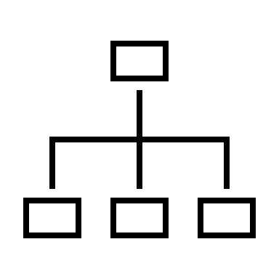
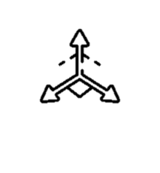

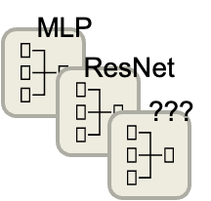





Backward Compatibility in Face Recognition
Shai Yehezkel and Lior Dvir Supervised by Elad Hirsch
Introduction
Visual recognition and retrieval systems are widely used in out lives, such in:
Frictionless physical access systems (Apple ID).
Missing person search.
Global Place Recognition.
Homeland Security applications.
Deep Neural Networks architectures progress fast.
Addressing queries in the new architecture w.r.t to the old architecture gallery is called the Cross Model Compatibility.
Preliminaries
Embedding Vector – a deep feature vector as an output of a NN (W\O Classification).
Embedding Space – The space spanned by embedding vectors.
Manifold – A hyper-surface in the embedding space where all embedding vectors reside.
Recognition - Querying an embeddings gallery by a vector and successfully retrieving a label.
Different networks have different embedding space and manifold.
NN
Embedding Vector
NN
Embedding Space
$$V=(x_{1},x_{2}…x_{n})$$
NN #1
Embedding Space A
Alice
NN
Embedding Vector
Search (Nearest Neighbor)
$$V_{2}$$
Person is Alice
Gallery Embeddings A
$$V_{1}$$
Query
Gallery Embeddings
NN #2
Embedding Space B
Gallery Embeddings B
$$V_{3}$$
Previous Work
Our work is based on a research by Wang et al.
Previous work suggests creating a unified transformer both to the new embedding space and original gallery embeddings.
Goal
We shall focus on implementing a transformer from the new embedding space into the original gallery embeddings.
We shall improve the transformer by adding new loss functions to our problem.
We shall augment our sample space via interpolation.
Training Query & Gallery
Using ArcFace dataset we have:
Trained a ResNet18 model as the old Gallery
Trained a ResNet50 model as the new Query
Both models achieved 96%-98% classification accuracy rate
Loss Functions
We have chosen two loss functions for the Transformer training:
Due to imbalance is their values, we use:
$L_{total}=α⋅CSL+β⋅MSE, where α≫β$
Models
MSResNet
MLP
NN #1
Embedding Space A
Search (Nearest Neighbor)
Gallery
Embeddings A
NN #2
Embedding Space B
Transformer
Embedding Space A'
Interpolation
We have created new synthetic labels by coupling real labels and averaging (interpolating) their samples
This is done on the embeddings themselves and not the images.
Evaluation
We measured accuracy using Nearest Neighbor by searching for the closest Gallery embedding to the transformed query
Results
Baseline was the MLP model with no interpolation (76.98%)
MSResNet performed poorly and dropped (61.31%)
MLP pre-trained on 25% interpolation data performed best (79.14%) – Improvement of ~2%
Improvements
More architectures
Better interpolation method Our chosen method has high risk of straying from Manifold
Embedding space proximity Embeddings of same label not dense enough in space
We assume the interpolated embedding keeps its location related to its ”parent” embeddings
Conclusions
Multiple loss functions need balancing
Deeper is not always better
Synthetic data needs to be utilized correctly
Architecture | Interpolation Rate | Training Method | Accuracy
MsResNet | - | - | 61.31%
 | 12% | Full Data | 59.97%
MLP | - | Full Data | 76.98%
 | 50% | Full Data | 74.25%
 |  | Pre-Train + Full Data | 74.29%
 | 25% | Full Data | 77.1%
 |  | Pre-Train + Full Data | 79.14%
Unified Representation Learning for Cross Model Compatibility [2020]
Chien-Yi Wang, Ya-Liang Chang, Shang-Ta Yang, Dong Chen, Shang-Hong Lai
May 2022

